Slide 1
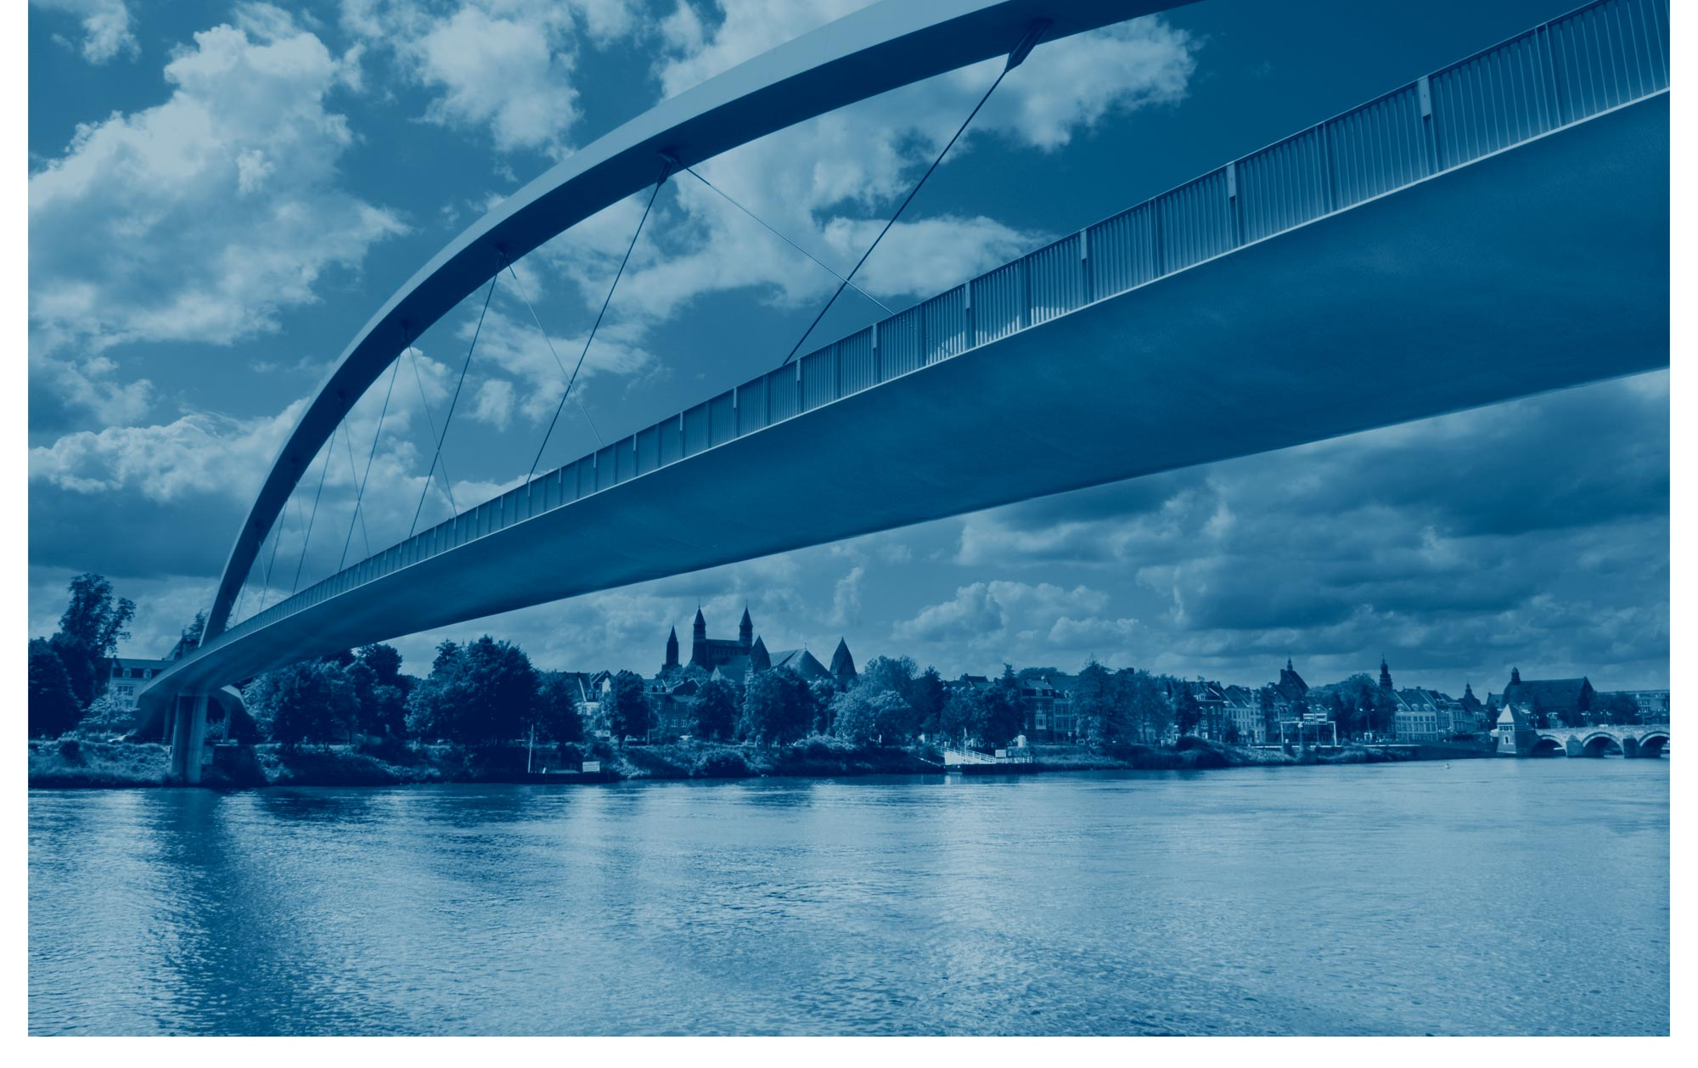
Facebook Motion Prediction
Pieter Schaap Florian Krebs
Bruno Guandalin Lubascher Tobias Moers

Slide 2

Thank you!

Slide 3
References

Slide 4
BACKUP

